Slide 1
Graphs

Slide 2
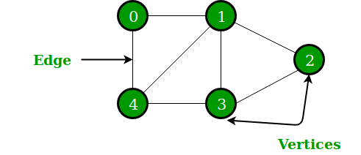
Introduction
A Graph is a non-linear data structure consisting of nodes and edges.
A Graph consists of a finite set of vertices(or nodes) and set of Edges which connect a pair of nodes.
In the above Graph, the set of vertices V = {0,1,2,3,4} and the set of edges E = {01, 12, 23, 34, 04, 14, 13}.

Slide 3
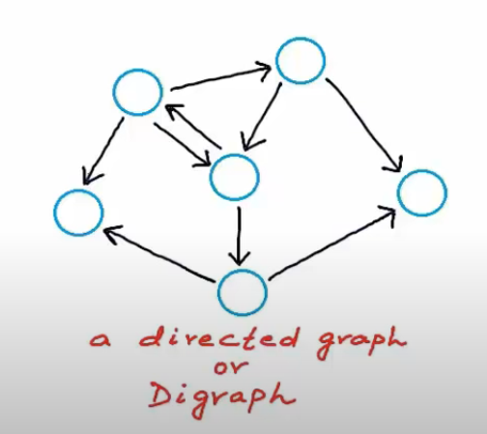
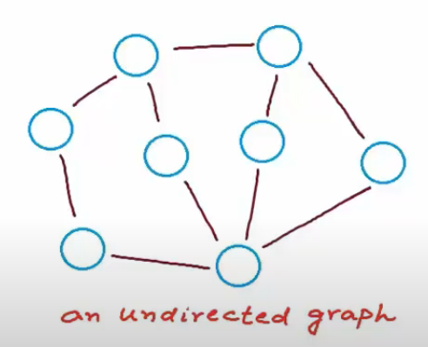
Introduction

Slide 4
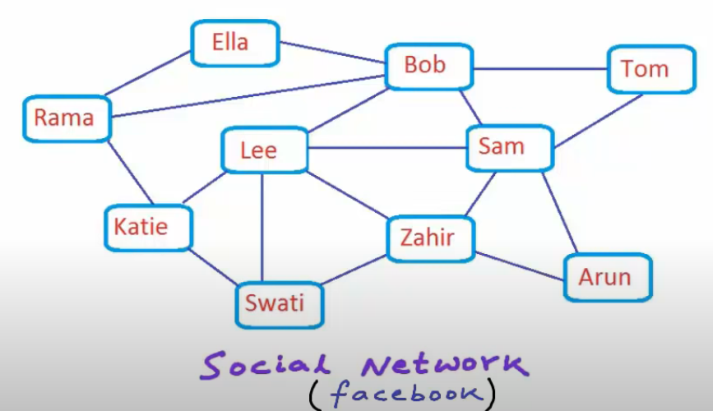
Introduction
Graphs are used to solve many real-life problems.
Graphs are used to represent networks.
The networks may include paths in a city or
telephone network or circuit network.
Graphs are also used in social networks like
linkedIn, Facebook.
For example, in Facebook, each person is
represented with a vertex(or node). Each
node is a structure and contains information
like person id, name, gender, locale etc.
Notes:
To recommend a friend the problem for the graph can be like find all the nodes that are having distance from a specific node less then 2.

Slide 5
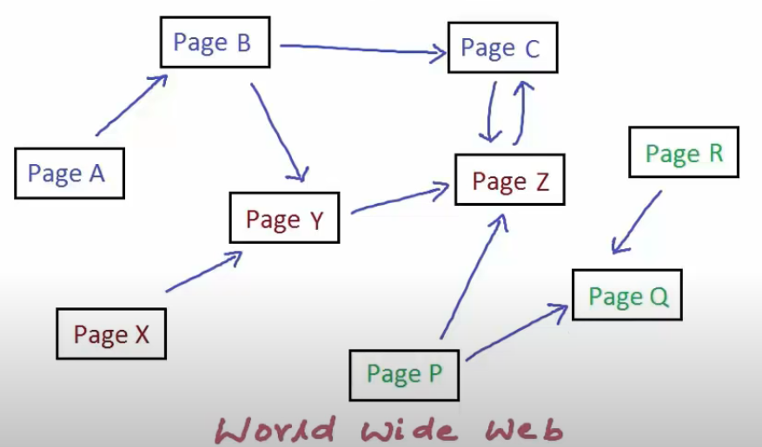
Introduction
World Wide Web can be represented as a directed graph.
A web page with unique address or url can be a node in this graph.
And a node can have a directed edge if that node or page has link to another page.
Notes:
web crawlers use this graph to traverse all nodes in the graph by visiting all the nodes connected with edge from the source node.

Slide 6
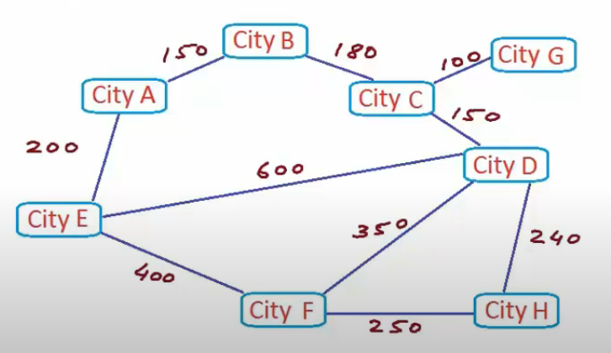
Introduction
Unweighted Graph
A weighted graph with all edges having weight = 1 unit.
Intercity Road Network

Slide 7
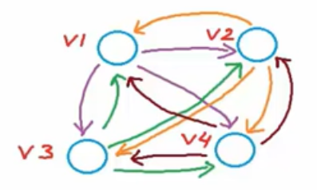
Properties
Number of edges:
if |v| = n
then,
0 <= |E| <= n(n-1), if directed
0 <= |E| <= (n(n-1))/2, if undirected
Dense → Too many edges (close to max no. of edges)
Sparse → Too few edges (close to no. of vertices)

Slide 8
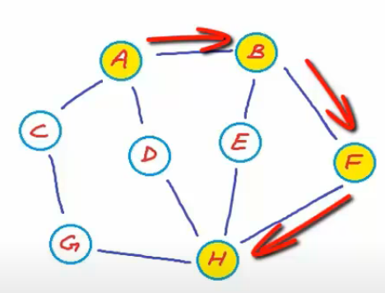
Properties
Walk:
A sequence of vertices where each adjacent pair is connected by an edge.
Path (Simple) :
A walk in which no vertices (and thus no edges) are repeated.
Trail:
A walk in which no edges are repeated.
Closed Walk:
starts and ends at same vertex.
Cycle:
no repetition other than start and end.
<A, B, F, H>
Notes:
<A, B, F, H> → simple path
<A, B, F, H, E, B, A, D> → walk
<A, B, E, H, D, A, C> → trail
<A, B, E, H, D, A> → closed walk

Slide 9
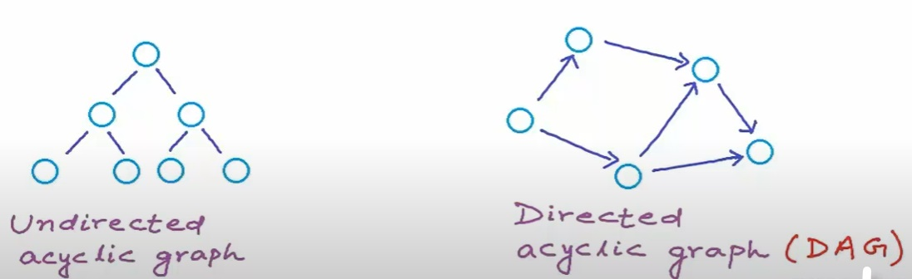
Properties
Acyclic Graph:
A graph with no cycle.
Notes:
A tree is undirected acyclic graph
There can be undirected acyclic graphs which are not trees and they are known as DAG.

Slide 10
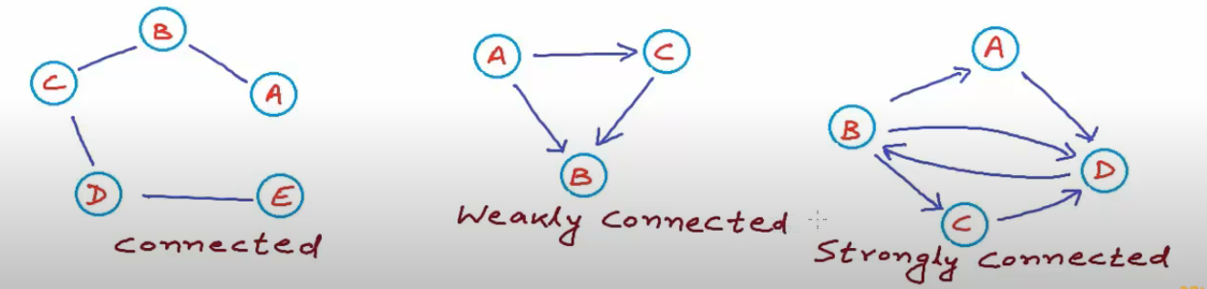
Properties
Strongly Connected Graphs:
if there is a path from any vertex to any other vertex.
Notes:
(i) if undirected graph, and there is path from any vertex to any other vertex, we simply call it connected.
(ii) if directed graph, and is not strongly connected but can be converted into connected graph by treating all edges as undirected then such graph is called weakly connected graph.
(iii) if directed graph, and there is path from any vertex to any other vertex, we call it strongly connected.

Slide 11
Representation
There are generally two ways to represent a graph data structure:
Adjacency Matrix
Adjacency List
There are other representations also like, Incidence Matrix and Incidence List.
The choice of the graph representation is situation specific.
It totally depends on the type of operations to be performed and ease of use.

Slide 12
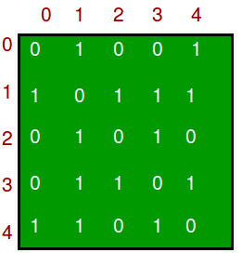
Adjacency Matrix
Adjacency Matrix is a 2D array of size V x V where V is the number of vertices in a graph.
Let the 2D array be adj[][], a slot adj[i][j] = 1 indicates that there is an edge from vertex i to vertex j. Adjacency matrix for undirected graph is always symmetric.
Adjacency Matrix is also used to represent weighted graphs.
If adj[i][j] = w, then there is an edge from vertex i to vertex j with weight w and all other values will be filled with some highest value or infinity.

Slide 13
Adjacency Matrix
Pros: Representation is easier to implement and follow. Removing an edge takes O(1) time. Queries like whether there is an edge from vertex ‘u’ to vertex ‘v’ are efficient and can be done O(1).
Cons: Consumes more space O(V^2). Even if the graph is sparse(contains less number of edges), it consumes the same space. Adding a vertex is O(V^2) time.

Slide 14
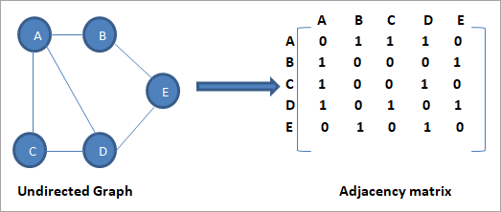
Adjacency Matrix

Slide 15
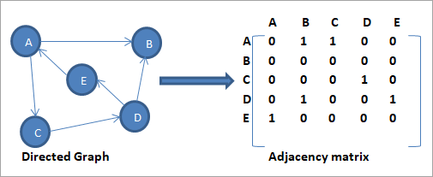
Adjacency Matrix

Slide 16
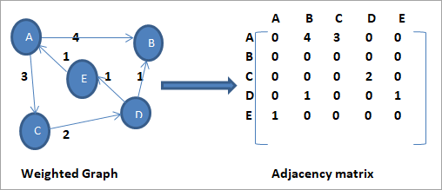
Adjacency Matrix

Slide 17
Adjacency Matrix - Representation
// undirected dense graph
int adj_matrix[N][N];
int main(){
int num_nodes, num_edges;
cin >> num_nodes >> num_edges;
for(int i = 0, u, v; i < num_edges; ++i){
// take nodes between which we have an edge
cin >> u >> v;
// undirected so we mark both (u, v) and (v, u) as 1
adj_matrix[u][v] = 1;
adj_matrix[v][u] = 1;
} // do something with the graph
}

Slide 18
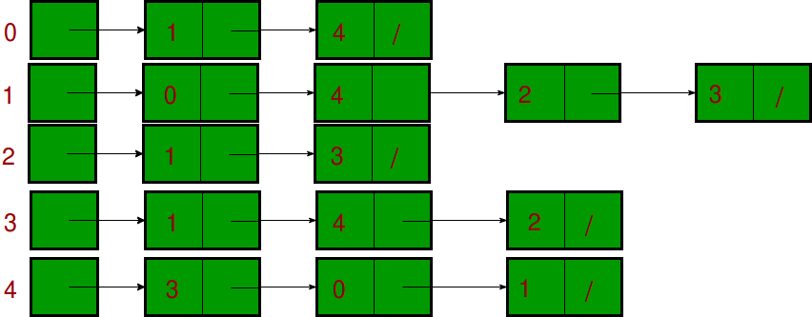
Adjacency List
An array of lists is used.
Size of the array is equal to the number of vertices.
Let the array be array[].
An entry array[i] represents the list of vertices adjacent to the ith vertex.
This representation can also be used to
represent a weighted graph.
The weights of edges can be represented as lists of pairs.

Slide 19
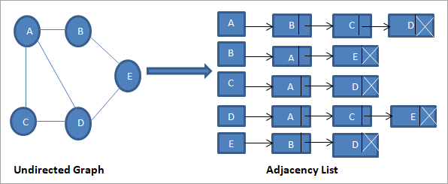
Adjacency List

Slide 20
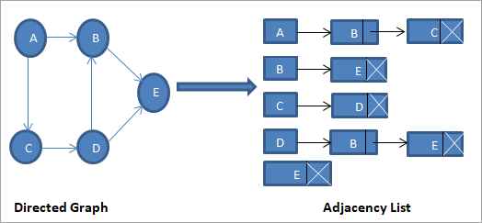
Adjacency List

Slide 21
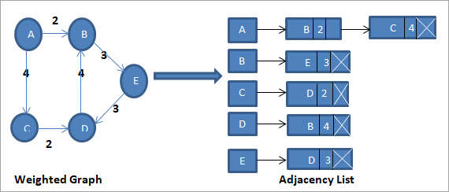
Adjacency List

Slide 22
Adjacency List - Representation
vector <vector <int> > adj_list;
int main(){
int num_nodes, num_edges;
cin >> num_nodes >> num_edges;
adj_list.resize(num_nodes+1);
for(int i = 0, u, v; i < num_edges; ++i){
// take nodes between which we have an edge
cin >> u >> v;
// undirected so we push v to list of u and vice versa
adj_list[u].push_back(v);
adj_list[v].push_back(u);
} // do something with the graph
}

Slide 23
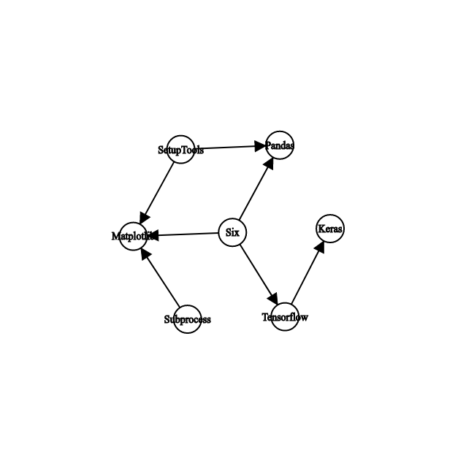
Application
The enthusiastic data scientist inside us wants to install some package to our system. But it depends on some other package which depends on some other and so on…. How many packages will you end up installing?
Often software dependencies are directed and can be modelled as a directed graph.
An edge from A to B denotes that B depends on A for its installation.

Slide 24
Application
How many packages are required to install Matplotlib? The answer is 3. How? We see the incoming edges to Matplotlib. :/
But is that it? Consider the case of Keras? What all is required for its installation? Clearly we need Tensorflow, which again requires Six to be available. So, here the answer is 2.
How to approach this problem?

Slide 25
Application
Let’s reverse the edges and see where we can reach from given package to be installed. Where-ever we reach is a dependency and needs to be installed before the package itself.

Slide 26
Traversal
There are two ways to do traverse a graph.
Let’s say you have a precious object which fell into a pool! Now you are searching for it in the pool. How will you do it?
Depth First Search: You start with some point on the pool’s surface, go as deep as you can (to the floor of the pool) and come back. If you don’t find your object, you take some neighbouring point on the surface and repeat the process.
Breadth First Search: You first search the entire surface of pool. Then go deep slighty and search entire area. Then a bit more deep and so on…

Slide 27
Depth First Traversal (DFS)
It is best option when trying to check if a graph is connected or not:
First it visits the starting node, which we call the root, and pushes it in a stack.
While the stack is not empty, the node at the top is examined and one of these two actions takes place:
If the node has unvisited neighbours, one of them is chosen, visited and pushed in the stack.
Otherwise, if all the node's neighbours had previously been visited the node presents no further interest and it is popped from the stack.
When the stack becomes empty it means that all the accessible nodes have been visited, so the algorithm ends.

Slide 28
Depth First Traversal (DFS)
int dfs(int node) {
int visCount = 1; //visited count
visited[node] = true;
for (int i=0; i<graph[node].size(); i++) {
if (!visited[graph[node][i]]) {
visCount += dfs(graph[node][i]);
}
}
return visCount;
}
Notes:
https://csacademy.com/lesson/depth_first_search/ ->video demo
https://www.techiedelight.com/depth-first-search/ -> iterative and recursive implementation

Slide 29
Breadth First Traversal (BFS)
It is one of the most common algorithms used to determine if a graph is connected or not. The steps of the BFS are the following:
Start by visiting one arbitrary vertex, which we call the root.
Visit all the root's neighbours and push them into a queue.
Pop the first node from the queue, visit all its neighbours and push into the queue those neighbours that have not been previously visited.
Repeat step 3 while the queue is not empty.
Finally, when the queue becomes empty it means all the reachable nodes have been visited, so the algorithm finishes.

Slide 30
Breadth First Traversal (BFS)
int bfs(int startNode) {
queue<int> bfsQueue;
vector<bool> visited(n);
int visCount = 0;
visited[startNode] = true;
bfsQueue.push(startNode);
while (!bfsQueue.empty()) {
int currentNode = bfsQueue.pop();
for (int i=0; i<graph[currentNode].size(); i++) {
if (!visited[graph[currentNode][i]]) {
visited[graph[currentNode][i]] = true;
bfsQueue.push(graph[currentNode][i]);
}
}
visCount += 1;
}
return visCount;
}
Notes:
https://csacademy.com/lesson/breadth_first_search/ -> video demo
https://www.techiedelight.com/breadth-first-search/ -> iterative and recursive implementation

Slide 31
What’s the time complexity ?
Given we have n nodes and m edges. We are going on each node once (thanks to visited array) and we also go on each of the edges once (consider the for loop in the function). So the complexity is O(n+m) for this implementation.

Slide 32
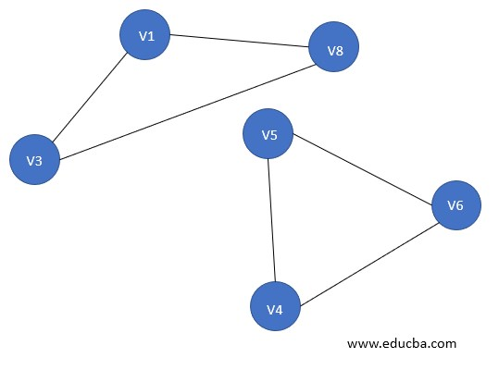
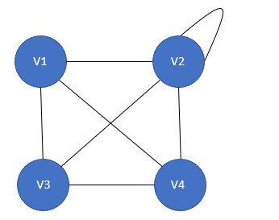
Connected and Disconnected Graphs
Connected Graph Disconnected Graph

Slide 33
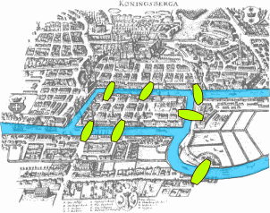
Königsberg problem
The town of Königsberg consists of two islands and seven bridges. Is it possible, by beginning anywhere and ending anywhere, to walk through the town by crossing all seven bridges but not crossing any bridge twice?
Notes:
There is a theorem that Euler used to show that it is in fact impossible to walk through the town and traverse all the bridges only once.

Slide 34
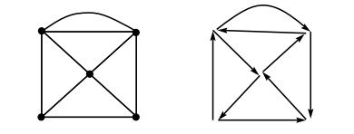
Terminology
Eulerian trail: An Eulerian trail is a trail that visits every edge of the graph once and only once. It can end on a vertex different from the one on which it began. A graph of this kind is said to be traversable.
Eulerian Circuit: An Eulerian circuit is an Eulerian trail that is a circuit. That is, it begins and ends on the same vertex.
Eulerian Graph: A graph is called Eulerian when it contains an Eulerian circuit.
The actual graph is on the left with a possible
solution trail on the right - starting bottom
left corner.

Slide 35
Theorem
An Eulerian trail exists in a connected graph if and only if there are either no odd vertices or two odd vertices.
NOTE: A vertex is odd if its degree is odd and even if its degree is even.
For the case of no odd vertices, the path can begin at any vertex and will end there; for the case of two odd vertices, the path must begin at one odd vertex and end at the other. Any finite connected graph with two odd vertices is traversable. A traversable trail may begin at either odd vertex and will end at the other odd vertex.
From this we can see that it is not possible to solve the bridges of Königsberg problem because there exists within the graph more than 2 vertices of odd degree.

Slide 36
Terminology
Hamiltonian Circuit: A Hamiltonian circuit in a graph is a closed path that visits every vertex in the graph exactly once. (Such a closed loop must be a cycle.)
A Hamiltonian circuit ends up at the vertex from where it started.
This type of problem is often referred to as the traveling salesman or postman problem.
Hamiltonian Graph: If a graph has a Hamiltonian circuit, then the graph is called a Hamiltonian graph.

Slide 37
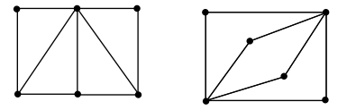
Eulerian & Hamiltonian Circuits
An Eulerian circuit traverses every edge in a graph exactly once, but may repeat vertices, while a Hamiltonian circuit visits each vertex in a graph exactly once but may repeat edges.
On the left, the graph is Hamiltonian and non-Eulerian, and
on the right, the graph is Eulerian and non-Hamiltonian.

Slide 38
Spanning Trees
A spanning tree is a subset of Graph G, which has all the vertices covered with minimum possible number of edges. Hence, a spanning tree does not have cycles and it cannot be disconnected..
By this definition, we can draw a conclusion that every connected and undirected Graph G has at least one spanning tree. A disconnected graph does not have any spanning tree, as it cannot be spanned to all its vertices.

Slide 39
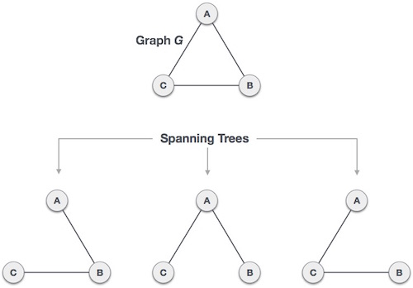
Spanning Trees
A complete undirected graph can have maximum n^{n-2} number of spanning trees, where n is the number of nodes.
In the above addressed example, n is 3, hence 3³⁻² = 3 spanning trees are possible.

Slide 40
General Properties of Spanning Trees
A connected graph G can have more than one spanning tree.
All possible spanning trees of graph G, have the same number of edges and vertices.
The spanning tree does not have any cycle (loops).
Removing one edge from the spanning tree will make the graph disconnected, i.e. the spanning tree is minimally connected.
Adding one edge to the spanning tree will create a circuit or loop, i.e. the spanning tree is maximally acyclic.

Slide 41
Mathematical Properties of Spanning Trees
Spanning tree has n-1 edges, where n is the number of nodes (vertices).
From a complete graph, by removing maximum e - n + 1 edges, we can construct a spanning tree.
A complete graph can have maximum nn-2 number of spanning trees.
Thus, we can conclude that spanning trees are a subset of connected Graph G and disconnected graphs do not have spanning tree.

Slide 42
Applications of Spanning Trees
Spanning tree is basically used to find a minimum path to connect all nodes in a graph. Common application of spanning trees are −
Civil Network Planning
Computer Network Routing Protocol
Cluster Analysis
Consider, city network as a huge graph and now plans to deploy telephone lines in such a way that in minimum lines we can connect to all city nodes. This is where the spanning tree comes into picture.

Slide 43
Minimum Spanning Tree (MST)
In a weighted graph, a minimum spanning tree is a spanning tree that has minimum weight than all other spanning trees of the same graph. In real-world situations, this weight can be measured as distance, congestion, traffic load or any arbitrary value denoted to the edges.

Slide 44

Problem : Number of connected components in undirected graph
Given n nodes labeled from 0 to n - 1 and a list of undirected edges (each edge is a pair of nodes), write a function to find the number of connected components in an undirected graph.
Example : Given n = 5 and edges = [[0, 1], [1, 2], [3, 4]]
Ans : 2

Slide 45
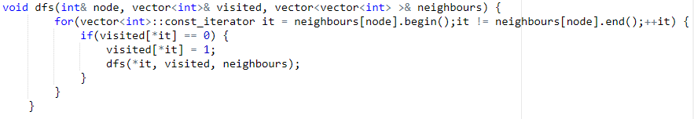
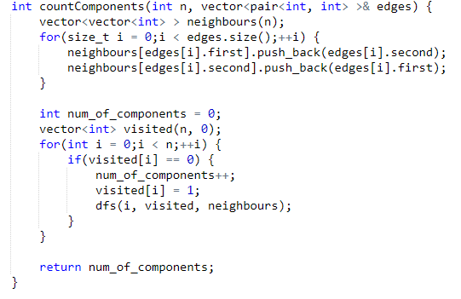
Implementation
Example : Given n = 5 and
edges = [[0, 1], [1, 2], [3, 4]]

Slide 46
Dijkstra’s Algorithm
Given a graph and a source vertex in the graph, find shortest paths from source to all vertices in the given graph.

